Slide 1

Ethical Interest in Free and Open Source Software

Slide 2
Behram ÇELEN
http://behram.org

Slide 3
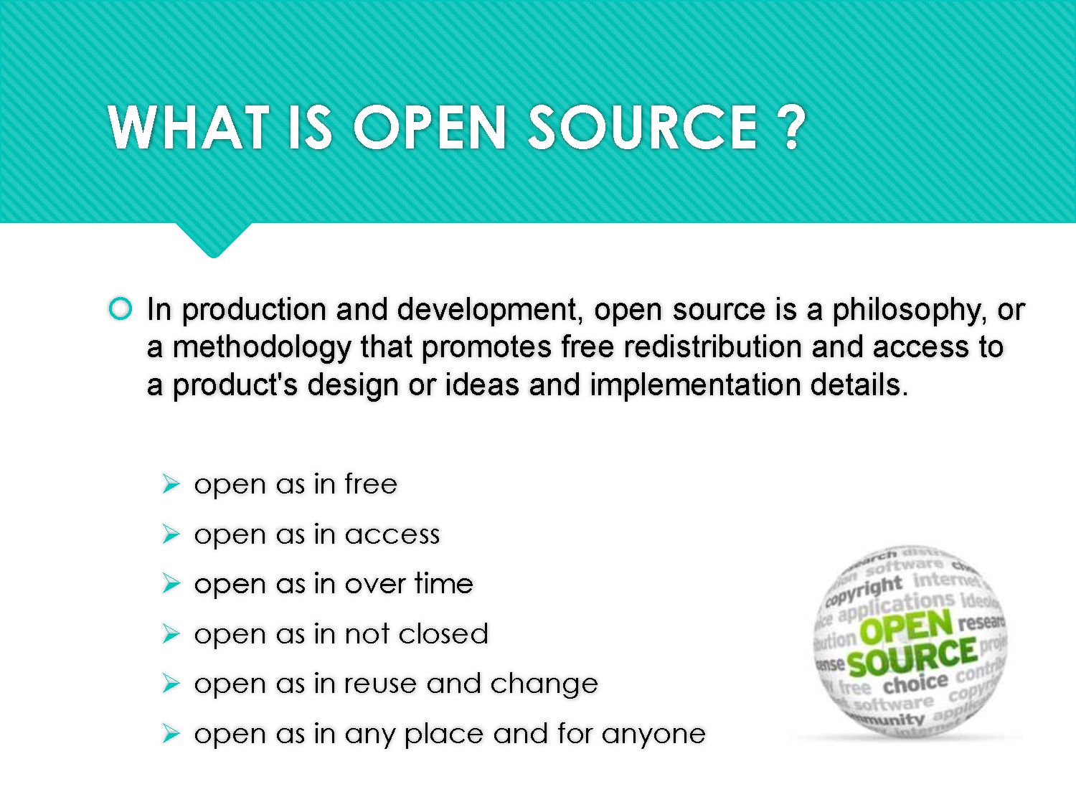

Slide 4


Slide 5
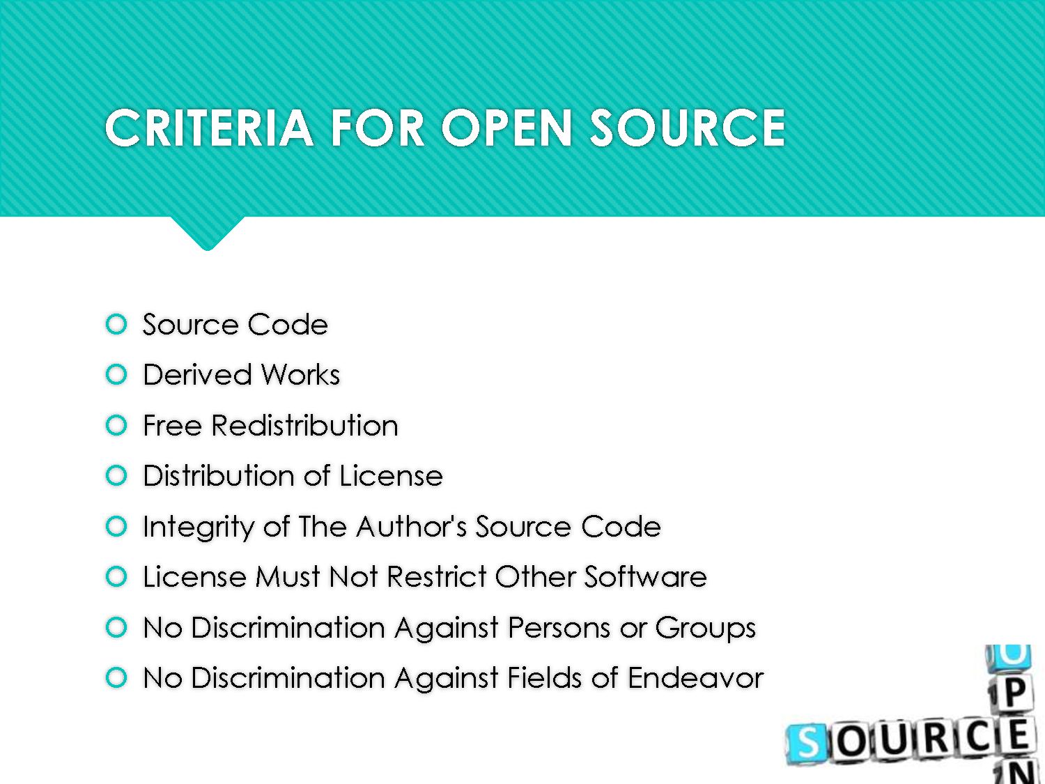

Slide 6
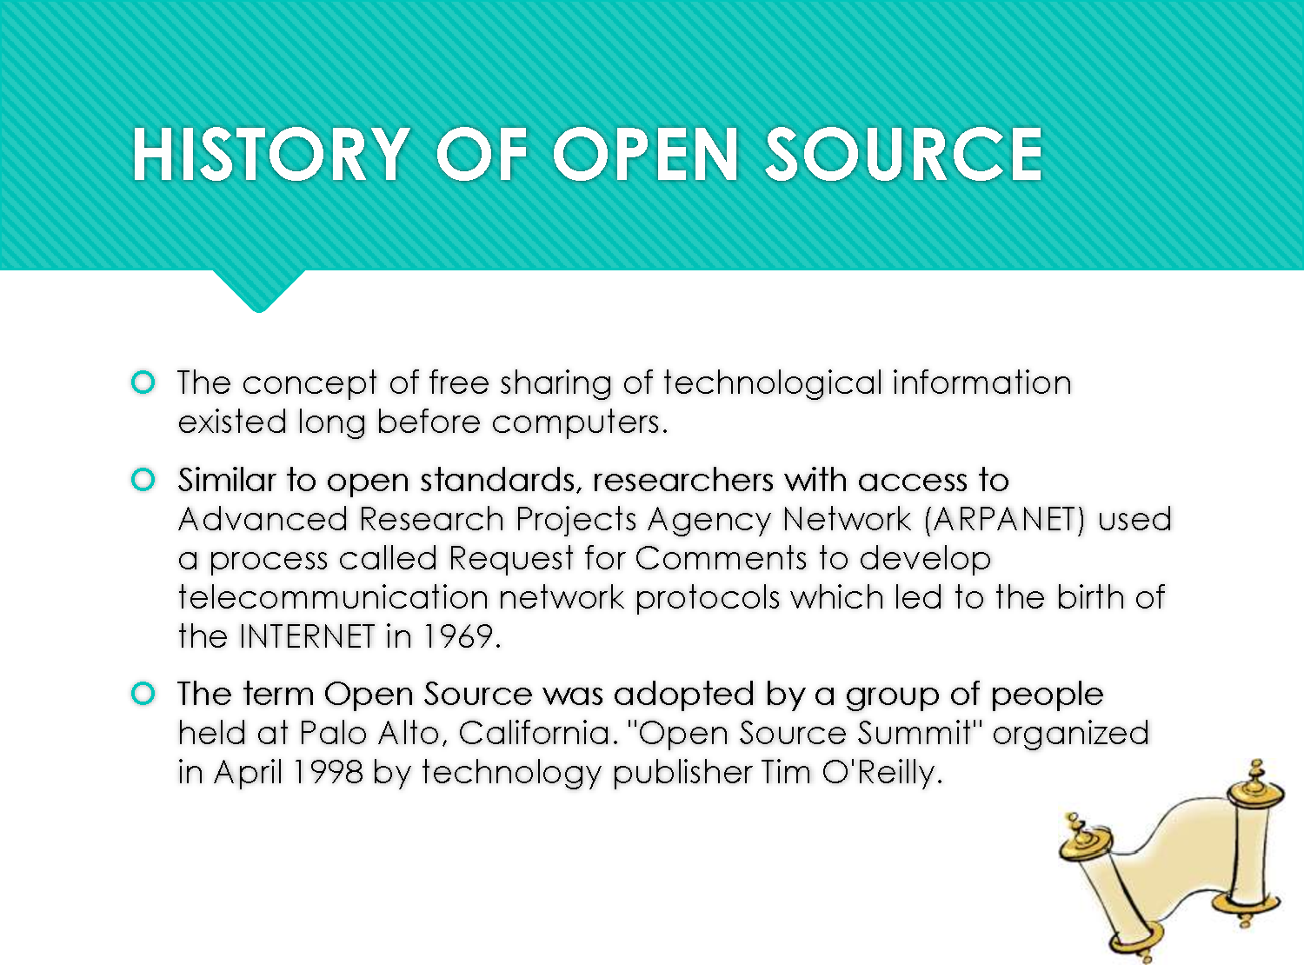

Slide 7
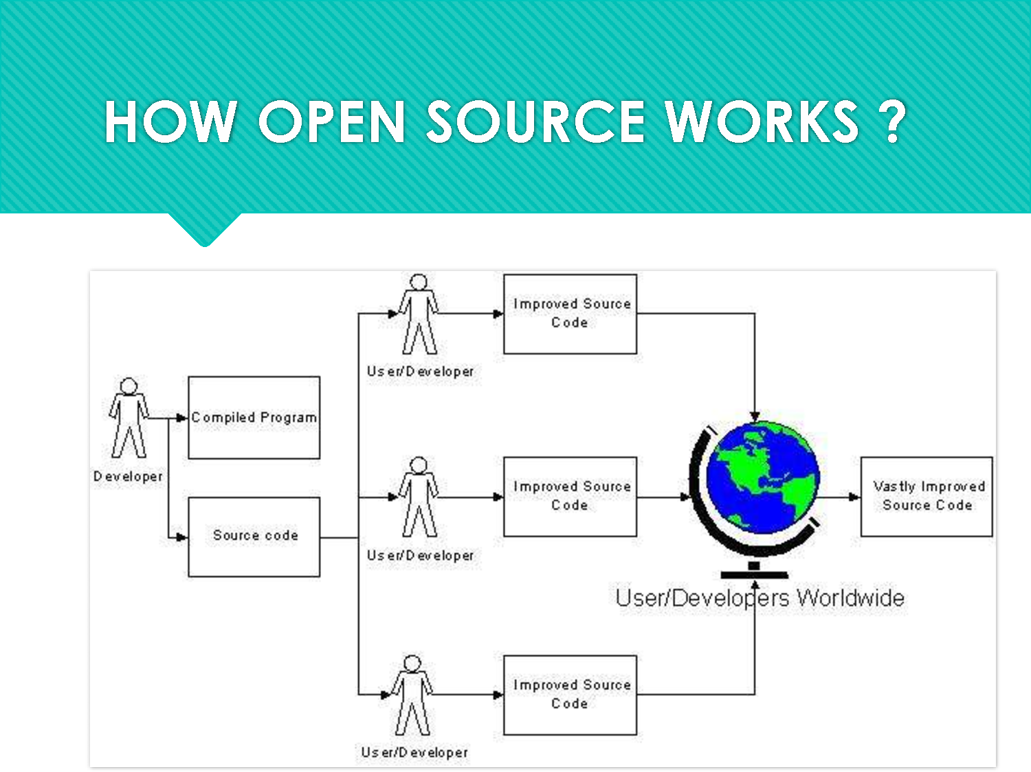

Slide 8
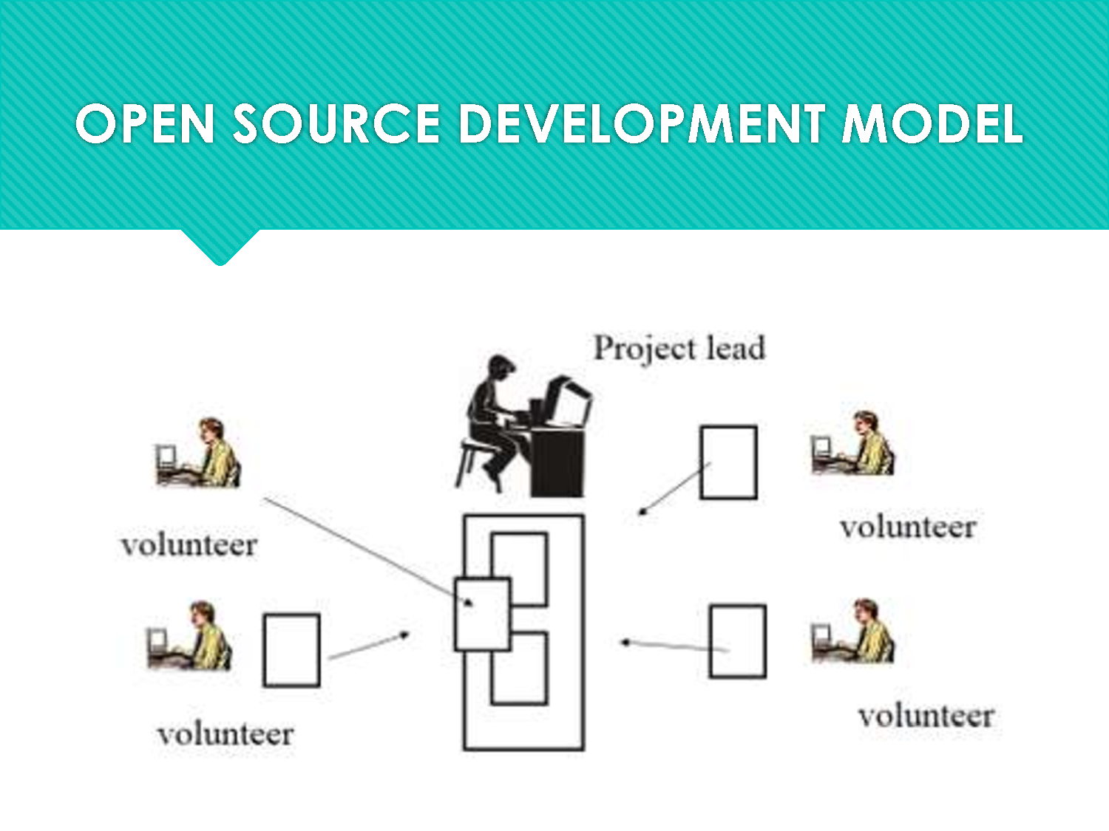

Slide 9
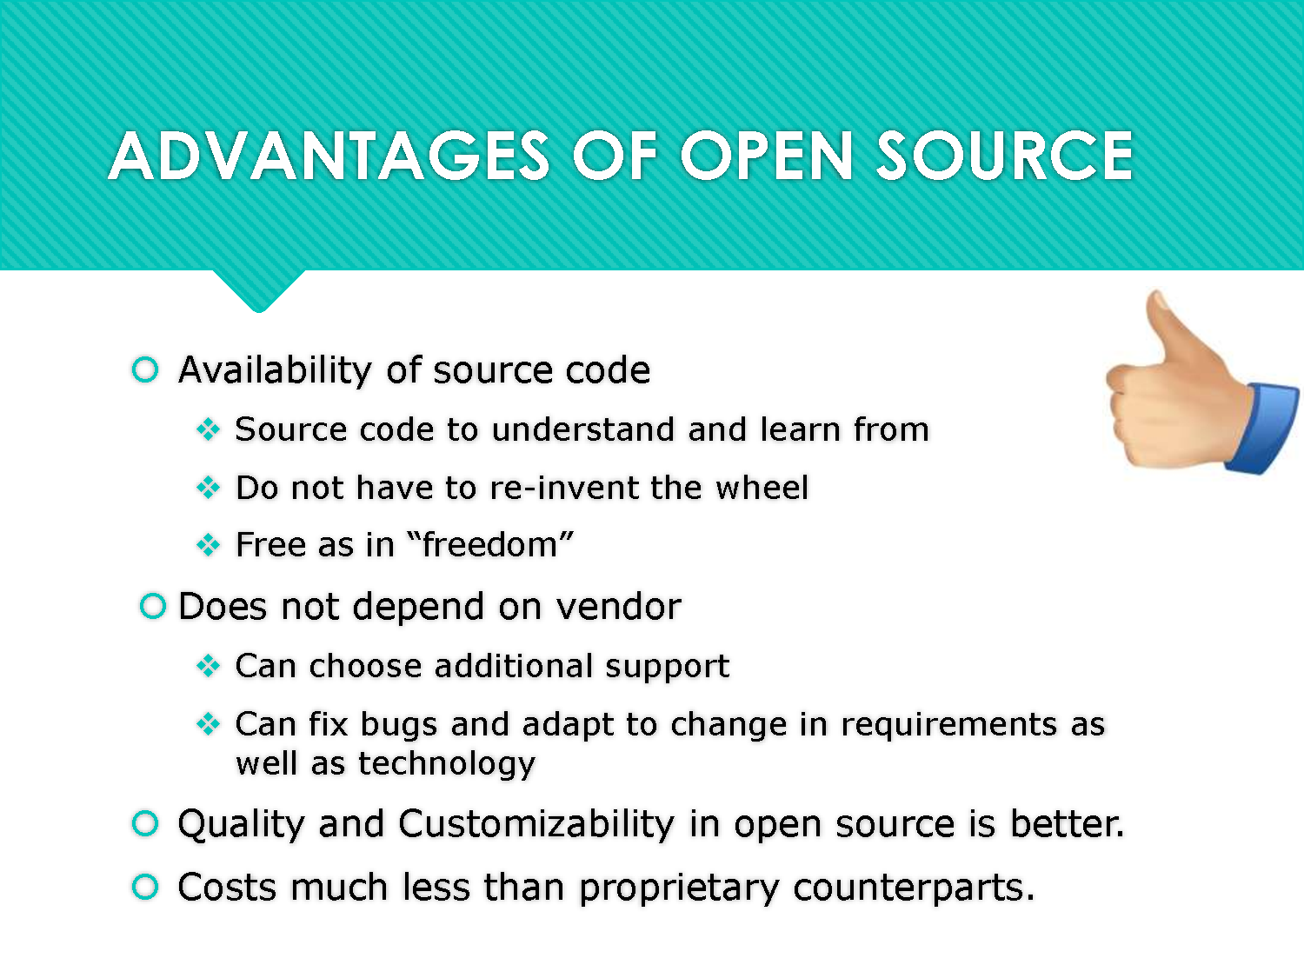

Slide 10
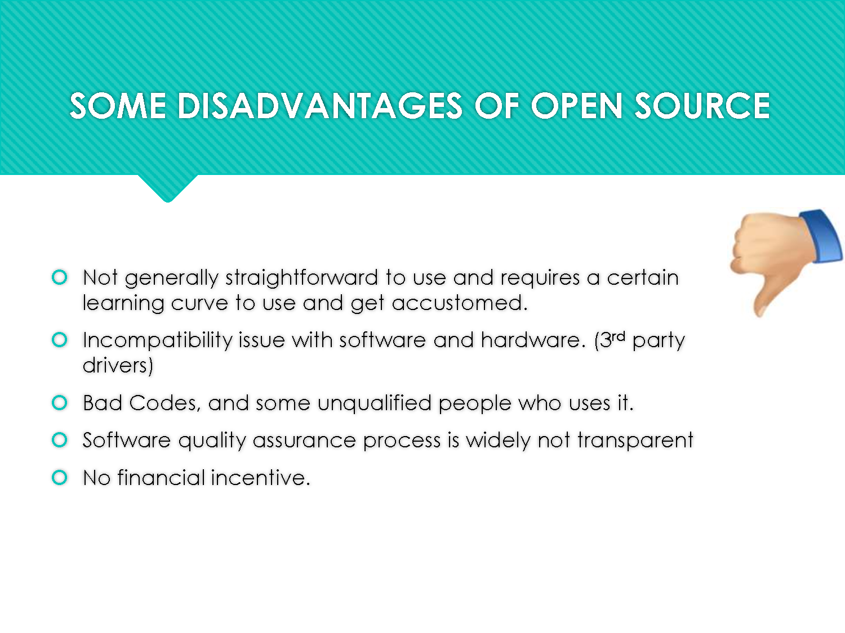

Slide 11
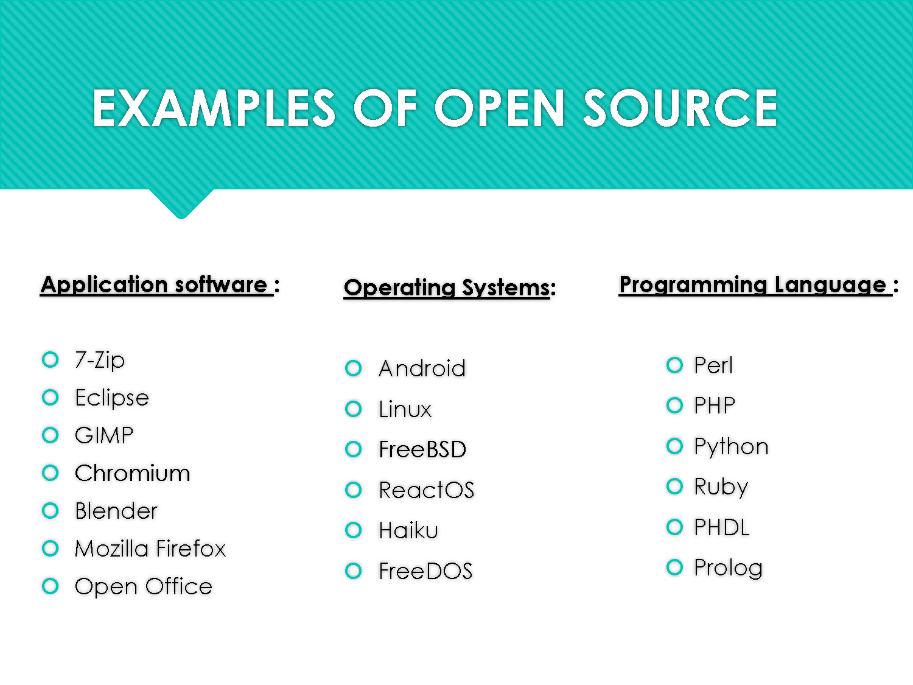

Slide 12


Slide 13


Slide 14
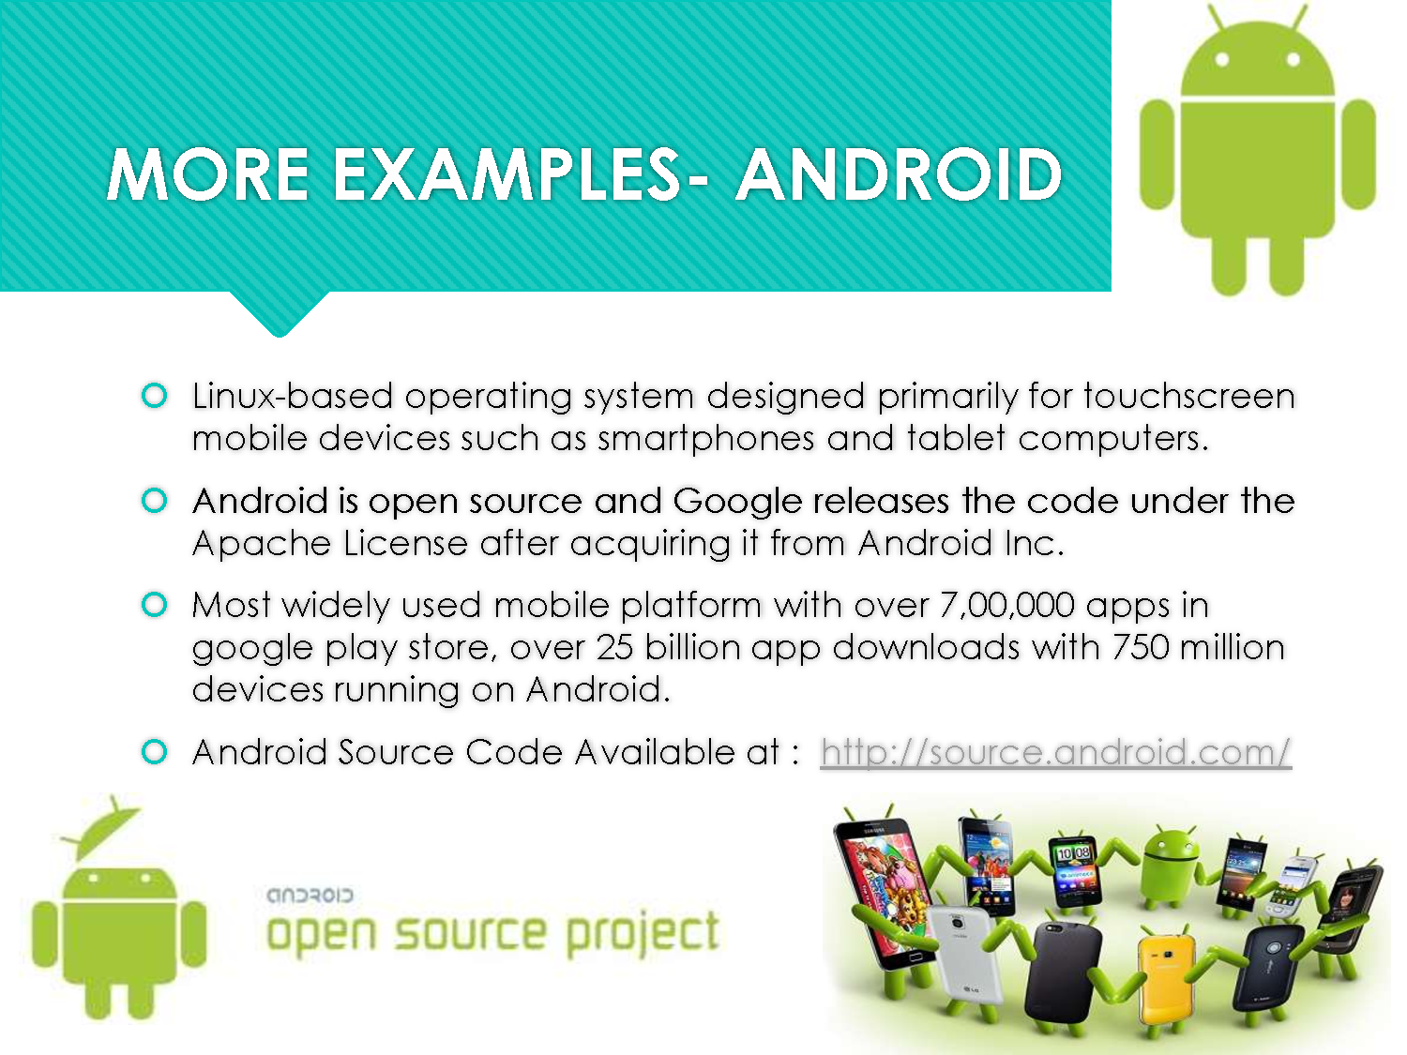

Slide 15


Slide 16


Slide 17
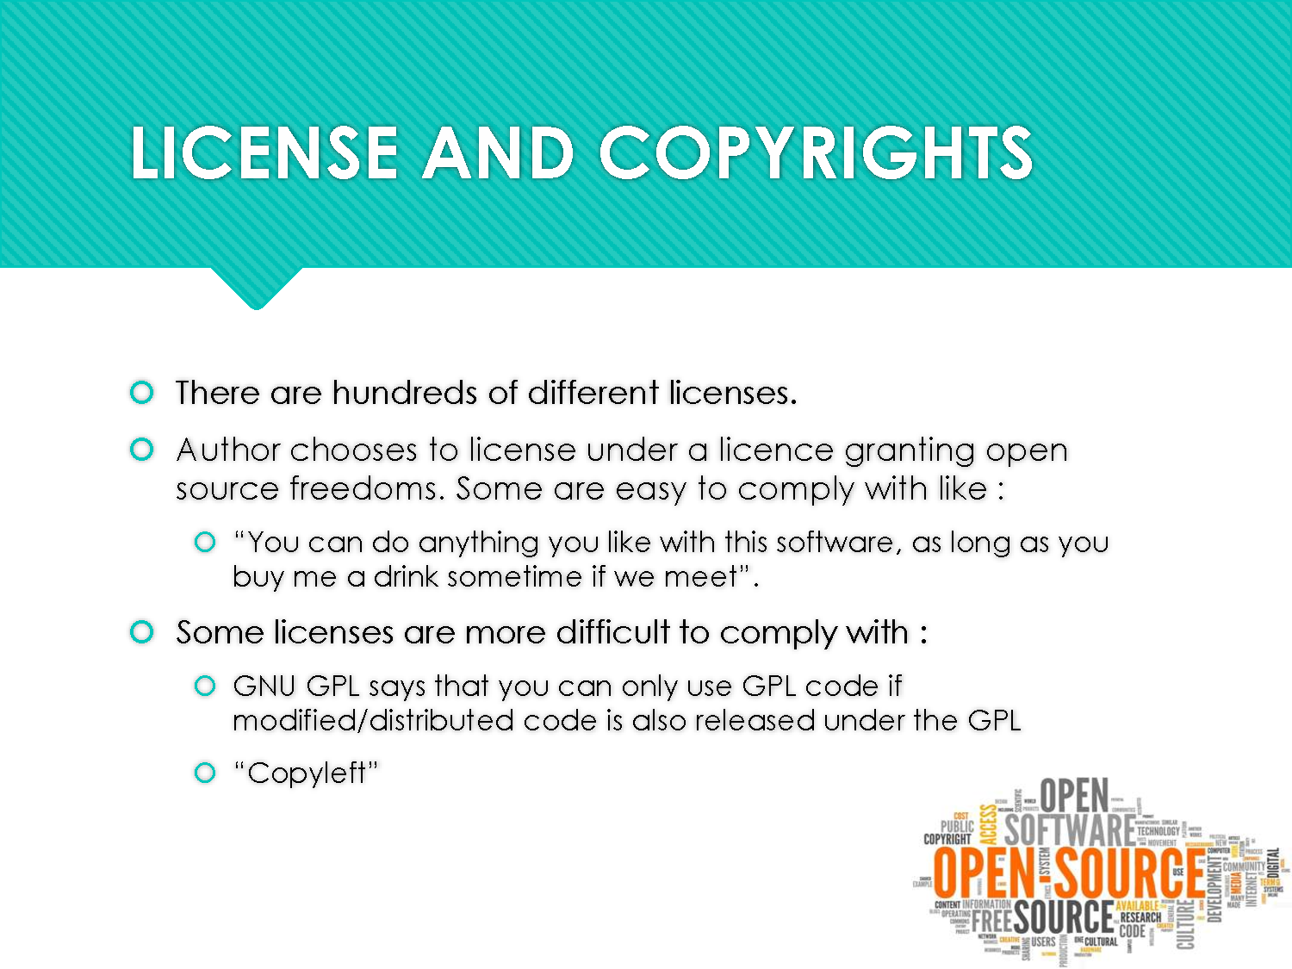

Slide 18


Slide 19


Slide 20


Slide 21

Thanks for Listening
behramcelen@gmail.com
You can find this presentation in github.com/behram/ComputerEthics

